Slide 1
WELCOME TO Year 3
Induction – Mr Smith

Slide 2
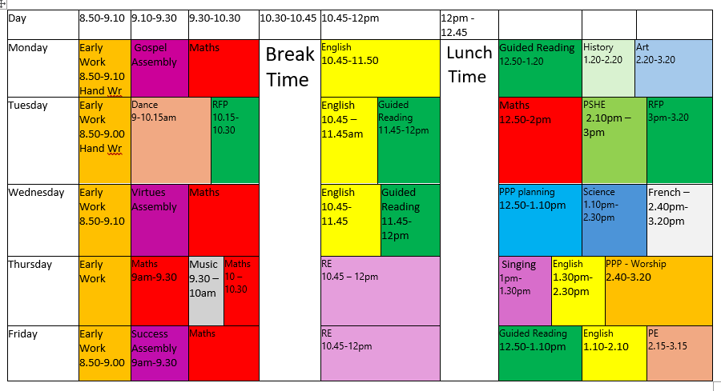

Slide 3

Spellings
Spelling will be sent home weekly
Tested on a Wednesday.

Slide 4

PE
Tuesday - Dance
Friday – Cricket
PE kit: Navy shirt, black/navy blue shorts, pumps or trainers.
Long hair tied back, no jewellery. (no earrings– LA policy)
Hoodie or tracksuit in cold weather if teacher allows, on top of kit not instead of.

